Slide 1
Chapter 2: Software Design with the
Unified Modeling Language
Session III: UML Behavioral Modeling

Slide 2
Session’s Agenda
UML behavioral modeling
  What is behavioral modeling?
  Why is it important?
Use case diagrams
  Actors
  System boundary
  Common relationships
Interaction diagrams
  Communication diagrams
  Sequence diagrams
  Concurrency modeling
Summary and conclusion of UML coverage

Slide 3
UML Behavioral Modeling
In the previous session, we presented structural modeling and made a case for how it is essential to evaluate, characterize, and visualize the structural design of software systems from various perspective. Specifically, we presented:
  Logical structural designs
    At different levels of abstraction
  Physical structural designs
We also presented (very vaguely) the concept of Quality and discussed how structural modeling can be used to evaluate and access quality in terms of some quality goals, such as reusability and maintainability.
Although structural designs work well for evaluating some quality attributes of systems, they are inadequate for others, such as performance.
  Structural designs also provide poor techniques for evaluating the dynamic aspects and interactions of systems.
UML provides several diagrams to model and reason about the dynamic aspects and of systems.
  These can be used to model almost any behavioral aspect of modern software systems
  They are used in many practical development projects.

Slide 4
UML Behavioral Modeling
From previous sessions, we learned that the most common UML behavioral diagrams include:
Other behavioral diagrams include:
  Timing diagram
  Interaction overview diagram
Behavioral Diagram | Description
Use Case Diagram | Used to capture, specify, and visualize required system behavior .
Sequence Diagram | Used to capture, specify, and visualize system interactions with emphasis on the time-order sequence of messages exchanged.
Communication Diagram | Used to capture, specify, and visualize system interactions with emphasis on the structural order of entities participating in the message exchange.
State Machine Diagram | Used to capture, specify, and visualize system behavior as a set of discrete states and the transitions between them.
Activity Diagram | Used to capture, specify, and visualize system behavior; provide mechanisms for modeling that includes conditional statements, repetition, concurrency, and parallel execution and thus can be used at many different levels of abstraction, from modeling business work flows to code.

Slide 5
UML Behavioral Modeling – Use Case Diagram
Use case diagram
  Behavioral diagram used to capture, specify, and visualize required system behavior.
    Required system behavior are just requirements!
  The main elements of use case diagrams are actors, use cases, and the relationships connecting them together.
Actors are entities used to model users or other systems that interact with the system being modeled (i.e., the subject). Examples include:
  Operators
  Sensors
  Client computers
Use cases are entities used in use case diagrams to specify the required behavior of a system.
  They provide the means to capture, model, and visualize the systems’ required behavior.
  They do this without any knowledge of programming technology, so that different stakeholders with different backgrounds can reason about the system.

Slide 6
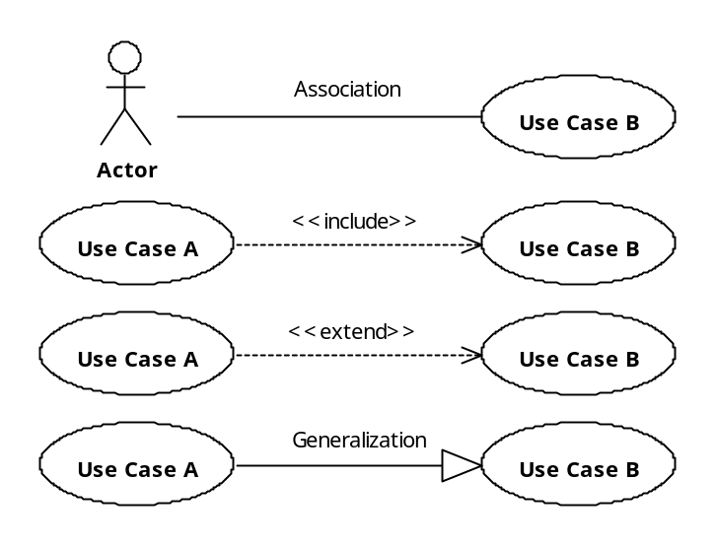
UML Behavioral Modeling – Use Case Diagram
Common UML relationships applied in use case diagrams.
Actor and use case communicate, for example, actor executes use case.
Named actor
Use case B MUST be executed when use case A is executed!
Use case A requires the behavior from use case B
Use case A extends the behavior of use case B. Use case B may be executed when use case A is executed, but it is not mandatory.
Use case A is a specialization of use case B
Important:
include relationship specifies a mandatory inclusion
Extend relationship specifies an optional inclusion

Slide 7
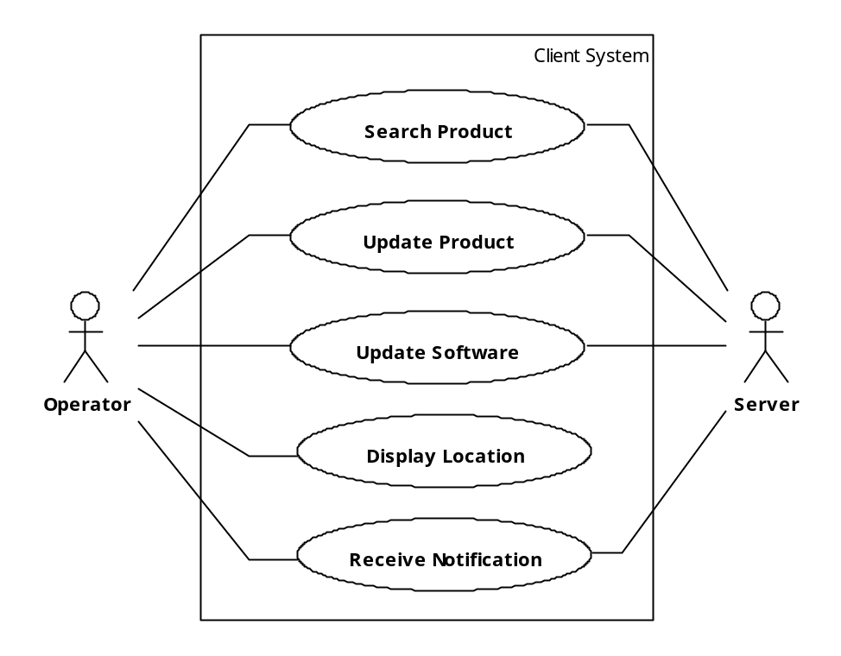
UML Behavioral Modeling – Use Case Diagram
Optional System Boundary to model the Subject
The Operator interacts with the Client System to search for products, update products, update software, display location, and receive notifications.
The Server also interacts with the Client System
This models the behavior of a client system. An Operator and Server both interact with the Client System, denoted by the System Boundary.

Slide 8
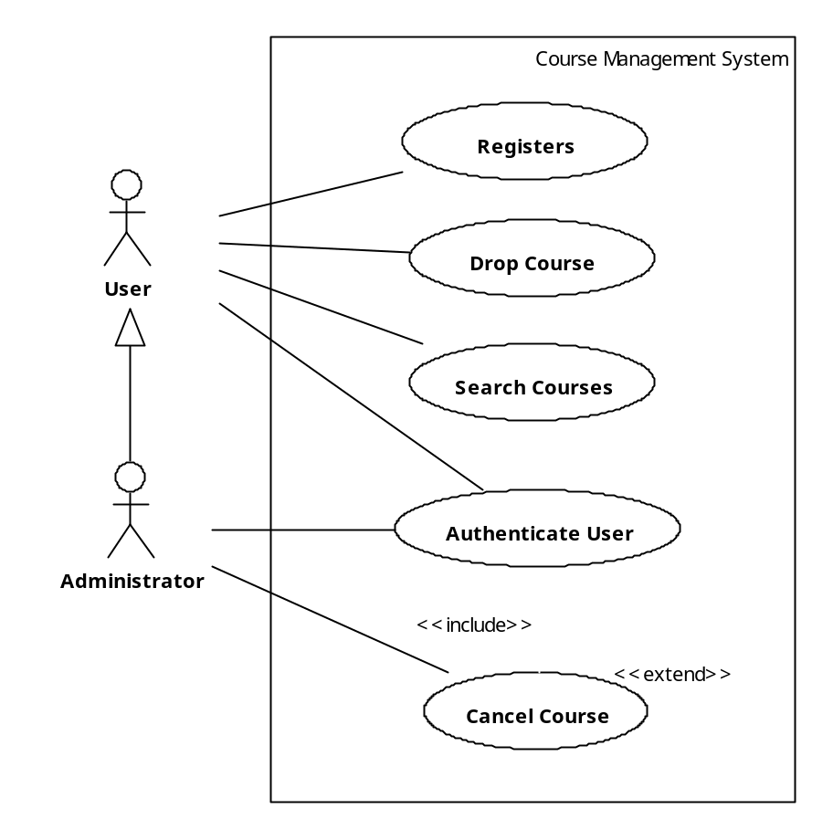
UML Behavioral Modeling – Use Case Diagram
Optional System Boundary to model the Subject
Actor interacts with the system.
To cancel a course, you may want to search for the course
A specialized user
Alternatively, you may want to enter the course number directly without searching for it.
You cannot cancel a course unless your identity has been authenticated!

Slide 9
UML Behavioral Modeling – Interaction Diagrams
Interaction diagrams can be used to model complex interactions between design units together with the messages exchanges and the type of the exchange.
Interaction diagrams can be used at the architectural level.
  For example, they allow us to model interaction among software components.
Interaction diagrams can be used at the detailed design level.
  For example, they allow us to model interactions among objects at run-time
Interaction diagrams can be used at the construction design level.
  For example, they allow us to model conditional and repetition structures.
In many situations, interaction diagrams reveal many important issues related to the quality of the system.
Two types of interaction diagrams are:
  Communication diagrams
  Sequence diagrams

Slide 10
UML Behavioral Modeling – Communication Diagram
Communication diagrams
  Behavioral diagrams used to capture, specify, evaluate, and visualize system interactions with emphasis on the structural order of entities participating in the message exchange.
When using communication diagrams, entities can be modeled as
  Objects, representing instances of classes and components.
  Roles, representing a prototypical instance
Both objects and roles can be connected to model the exchange of messages using:
  Links to connect objects
  Connectors to connect roles
  Both links and connectors look exactly alike, as a solid line. They only differ semantically.
The type of message exchanges include:
  Asynchronous
  Synchronous

Slide 11
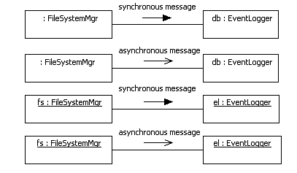
UML Behavioral Modeling – Communication Diagram
In synchronous messaging, sender and receiver work in lock-step to achieve an operation.
FileSystemMgr Role.
EventLogger Object.
In asynchronous messaging, sender continues execution while receiver completes operation independent from the sender
Asynchronous messaging between two run-time object instances
Important:
Synchronous and Asynchronous messaging are are important when reasoning about concurrency issues!

Slide 12
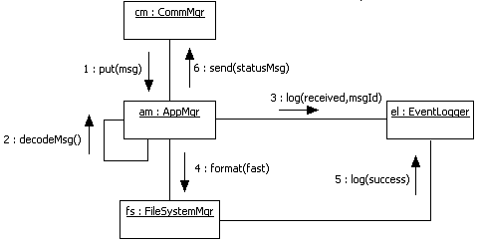
UML Behavioral Modeling – Communication Diagram
Communication diagram of objects at run-time using synchronous messaging
1. The “cm” object of type CommMgr sends a message to another object of type AppMgr.
3. The “am” object sends a message to the “el” object to log an event indicating the receipt of the message
2. The “am” object decodes the message. If finds out that the message commands a file system format operation
4. The “am” object sends a message to the “fs” object to begin erasing the data from the file system
5. Once complete, the “fs” object sends a message to the “el” object to log an event indicating success
Given this model, can “cm” begin other operations before the file system format is complete?

Slide 13
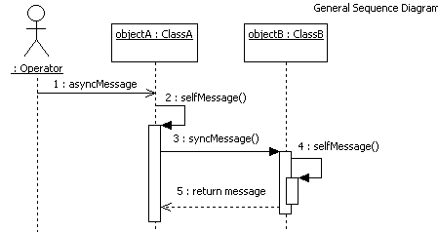
UML Behavioral Modeling – Sequence Diagram
  Sequence diagrams
    Similar to Communication diagrams, but, they put emphasis on the time-order sequence of messages exchanged.
Objects
Lifeline
Activation Bar
Optional modeling of return message

Slide 14
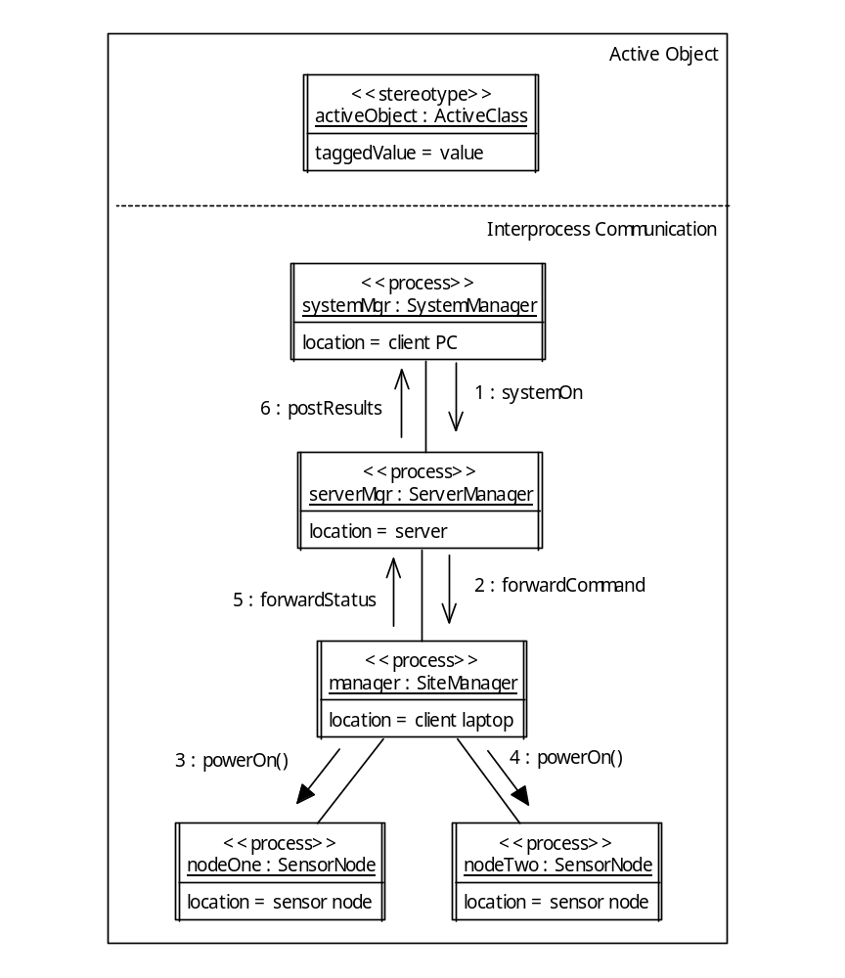
UML Behavioral Modeling
  Finally, a word about concurrency…
We use Active Objects to model independent flows of control, e.g., processes.
SystemManager process, located on client PC does not have to wait until Sensor Nodes are powered on to begin doing other work
We use stereotype <<process>> to specify these are actual run-time processes.
()
()
Asynchronous messaging
We use Tagged Values to specify the location of the running processes.
()
()
SiteManager works in lock-step with nodeOne. Once nodeOn is powered on, then SiteManager initiates power on sequence of nodeTwo
Synchronous messaging

Slide 15
What’s Next…
Now that we are equipped with the necessary UML tools, we can now explore how to used them to design a software architecture.
In the next session, we will present Software Architecture in more detail, including :
  Understanding the role of software architecture within the design phase.
  Explore in more detail the architectural tasks and problem-solving during architecture.

